Slide 1
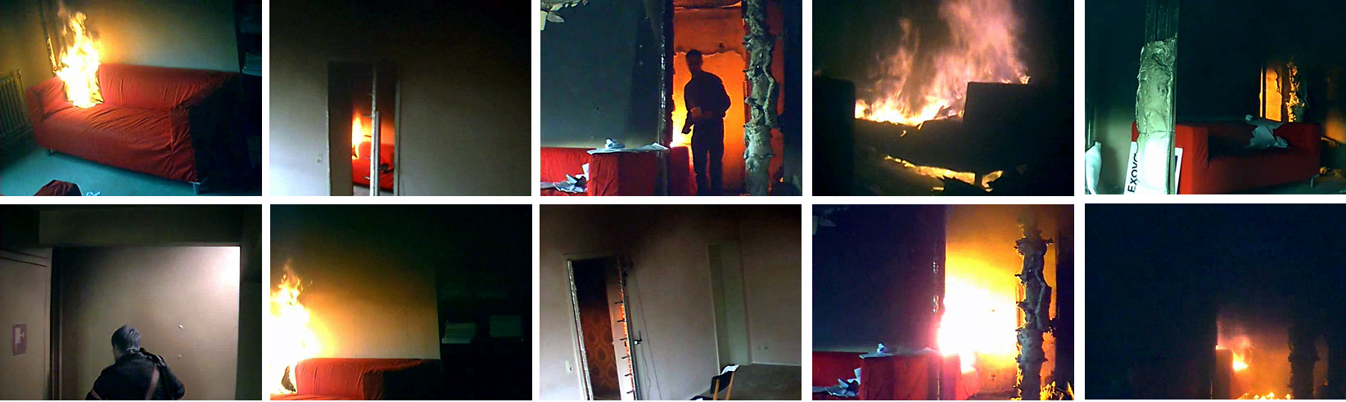
RABOT2012
Presentation of a Multi-View Video Dataset
of the Full-Scale (‘Rabot’) Fire Tests
Steven Verstockt
T. Beji, B. Merci & R. Van de Walle
May 7th, 2013
ISFEH – Providence, R.I., USA
7th International Seminar on Fire and Explosion Hazards

Slide 2
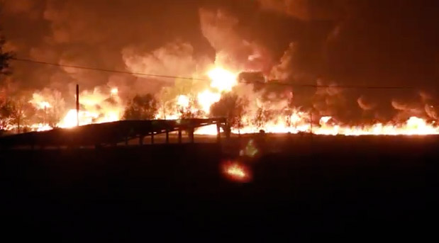
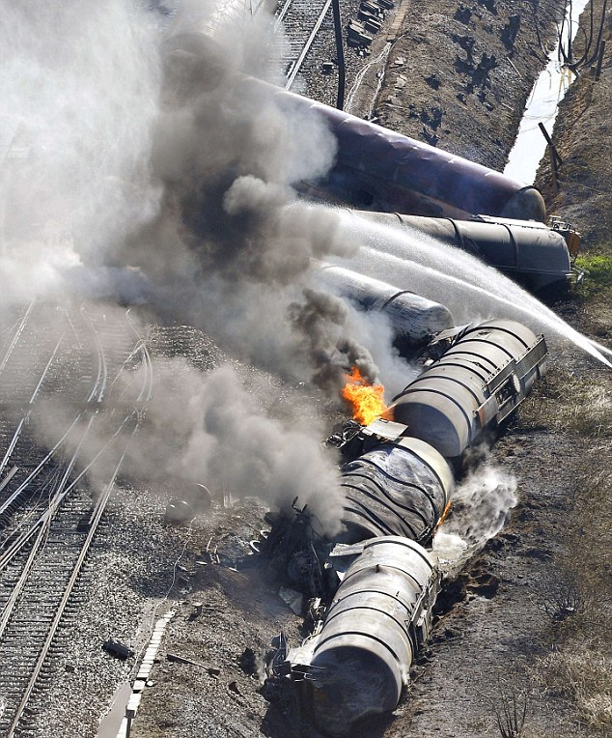
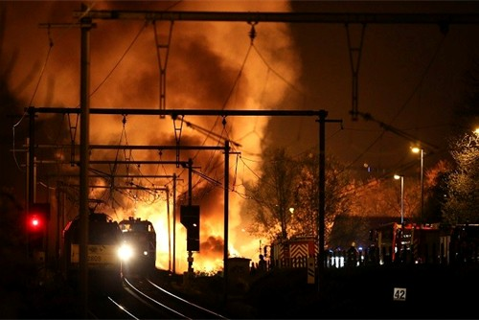
Fire and explosion hazards … close to Ghent
A Belgian train (carrying chemicals) derailed early Saturday, causing several explosions and a fire.
S. Verstockt – RABOT2012 multi-view video dataset

Slide 3
Overview
RABOT2012 (-> presentation of T. Beji at 14:20 today!!!)
The need for a “multi-view video dataset”?
RABOT2012 website
  > Sensor data: multi-view videos / thermocouple & velocity profiles
  > Images / observations / scheme of set-up / UCFIRE XML
Video-based flame spread analysis / smoke height estimation
  > Algoritm description / results / evaluation
  > Multi-view extension of single-view algorithms
Conclusions / Questions
S. Verstockt – RABOT2012 multi-view video dataset

Slide 4
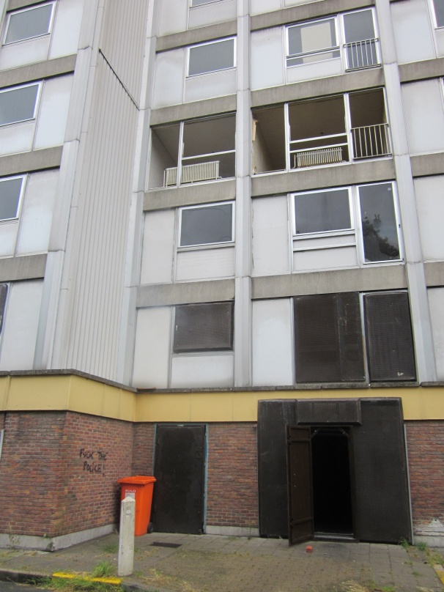
RABOT2012
Recordings of four large-scale multi-compartment fire tests that were conducted in an apartment in one of the ‘Rabot’ towers in the city of Ghent (Belgium) at the end of September 2012.
General overview & characterization of the tests -> presentation of T. Beji
S. Verstockt – RABOT2012 multi-view video dataset

Slide 5
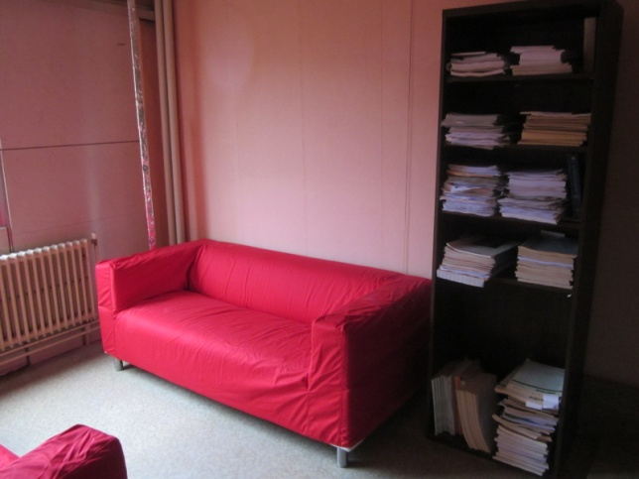
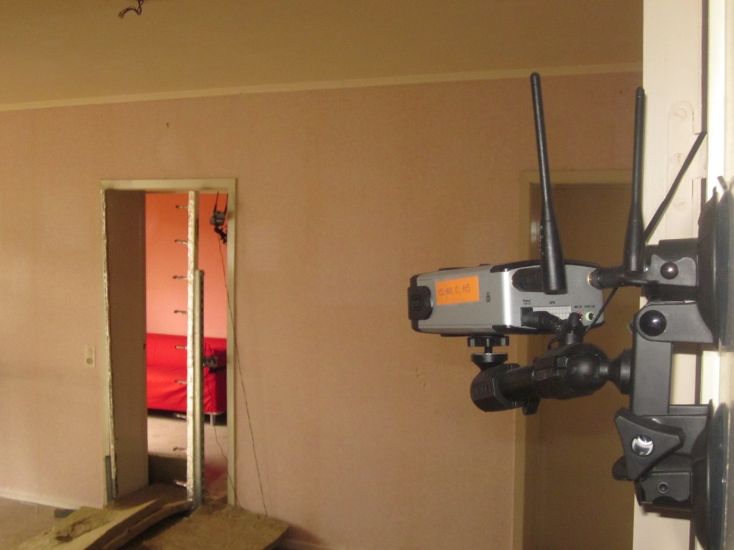
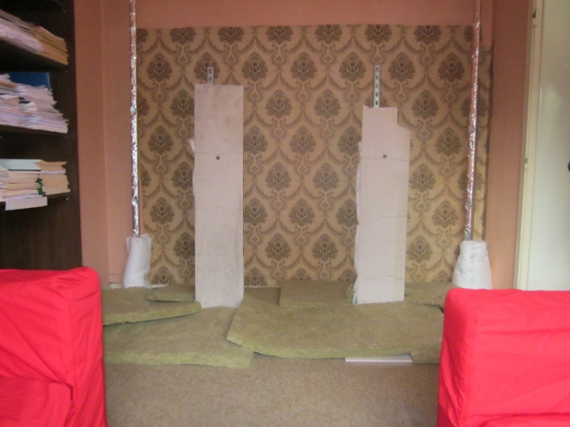
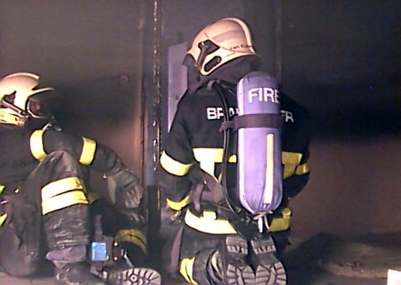
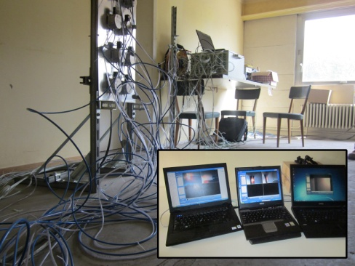
RABOT2012
S. Verstockt – RABOT2012 multi-view video dataset

Slide 6
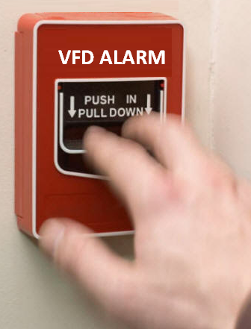
The need for a multi-view video dataset?
Limitations in current video fire detection (VFD) evaluation
1) Limited number of (publicly available) fire datasets
2) The absence of multi-sensor (ground truth) data
3) The extensive use of heuristic thresholds
4) NO standardized evaluation criteria and metrics.
→ NO objective VFD / VFA performance evaluation
The proposed dataset, and its annotated sensor data, should help to facilitate the evaluation process and provide a tool to correctly validate the effectiveness of video-based detectors.
S. Verstockt – RABOT2012 multi-view video dataset

Slide 7
The need for a multi-view video dataset?
Existing datasets?
consist of short clips showing one particular stage of the fire
are recorded in a controlled set-up
often unrealistic for real-world surveillance
Recording of end-to-end fires in realistic scenes,
as done in the ‘Rabot’ fire tests, makes our dataset
to be more suitable for VFD in real world.
Novel aspects of our work/set-up: test existing VFA algorithms in a multi-compartment set-up → extension of a single-view algorithm
→ multi-view WIN-WIN (within-/between variance)
S. Verstockt – RABOT2012 multi-view video dataset

Slide 8
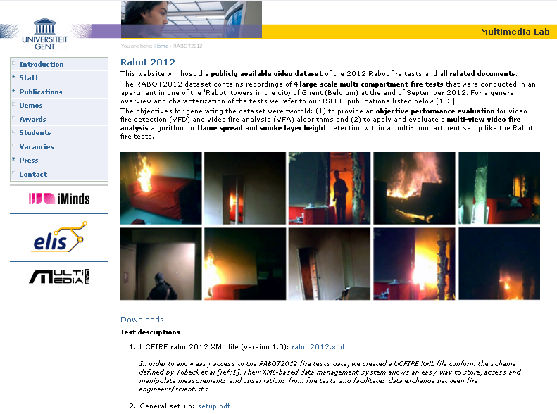
The RABOT2012 website
http://multimedialab.elis.ugent.be/rabot2012/
DOWNLOADS
S. Verstockt – RABOT2012 multi-view video dataset

Slide 9
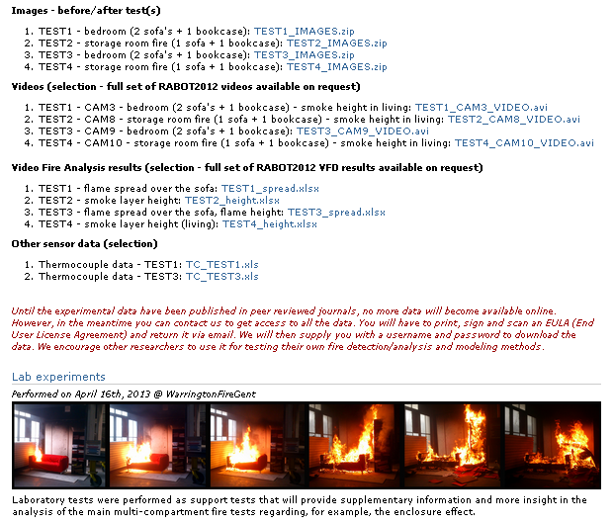
The RABOT2012 website
http://multimedialab.elis.ugent.be/rabot2012/
S. Verstockt – RABOT2012 multi-view video dataset

Slide 10
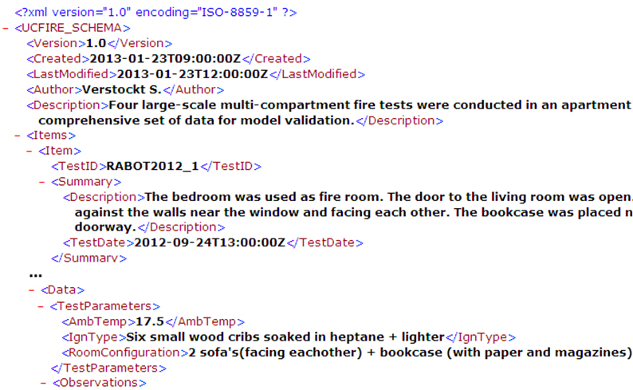
The RABOT2012 website
http://multimedialab.elis.ugent.be/rabot2012/
RABOT2012 UCFIRE XML doc
Easy way to store, access and manipulate
measurements and observations from fire tests.
Tobeck et. al.: “Data Structures for Fire Test Information
Exchange Using XML,” Fire Technology 49 – 2013.
S. Verstockt – RABOT2012 multi-view video dataset

Slide 11
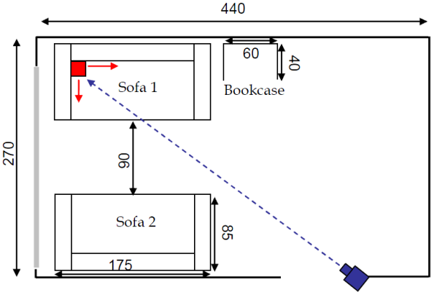
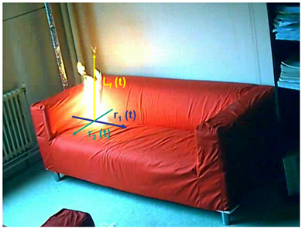
Video-based flame spread analysis
Camera calibration (alignment on the sofa –> 3D homographic projection)
FireCube: a Multi-View Localization Framework for 3D Fire Analysis, Fire Safety Journal 46(5) – 2011.
To follow the temporal evolution of flame height/spread, we need to be able to extract the flame pixels from the consecutive video images.
S. Verstockt – RABOT2012 multi-view video dataset

Slide 12
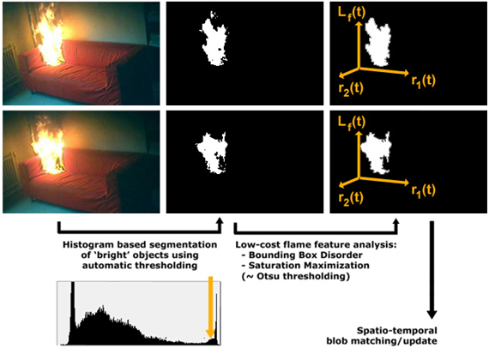
Video-based flame spread analysis
~ dominant peak/valley detection
S. Verstockt – RABOT2012 multi-view video dataset

Slide 13
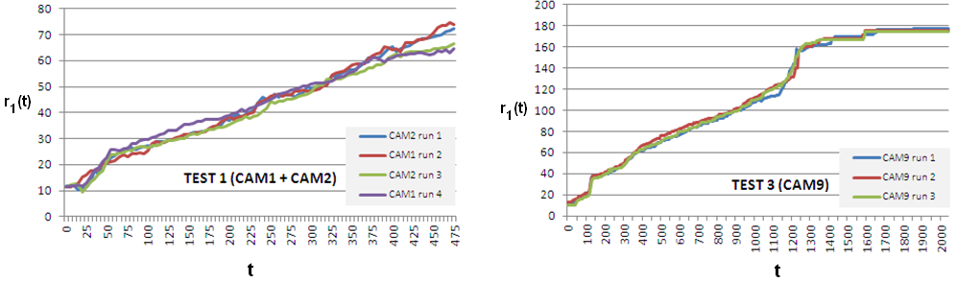
Video-based flame spread analysis: results
Comparison of horizontal flame spread between TEST1 / TEST3
→ a similar evolution/trend is noticed over a comparable time span
TEST 1: camera in smoke layer, leading to inaccurate data
→ we lowered the camera height to stay under smoke layer (TEST 3)
→ future tests: combination of visual / (LW)IR cameras
(ISFEH paper of J. de Vries et al. – FM GLOBAL / image registration-synchronization)
S. Verstockt – RABOT2012 multi-view video dataset

Slide 14
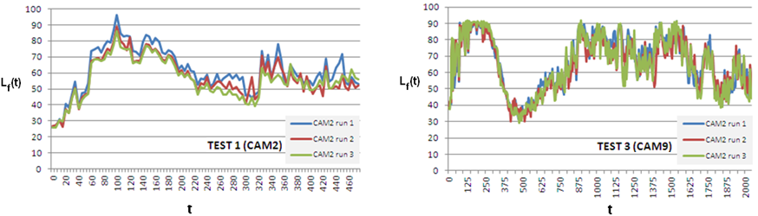
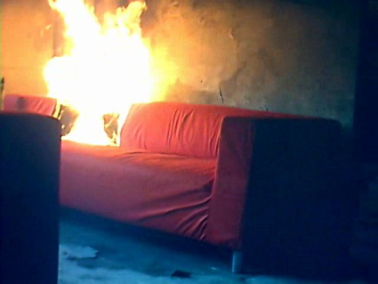
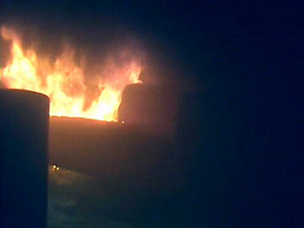
Video-based flame spread analysis: results
Evolution of the flame height
Again, similar trends are observed
e.g. (high) decrease of L_{f}(t)
around t=300s
Also noticed in lab experiments!
S. Verstockt – RABOT2012 multi-view video dataset

Slide 15
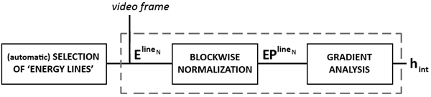
Video-based smoke height estimation
Key component of the algorithm is the Discrete Wavelet Transform (DWT) based evaluation of Video Energy Lines.
Video Energy Lines show strong similarity with thermocouples that are used for temperature profile analysis.
Proposed method is based on a commonly used technique for the determination of the smoke layer interface height.
S. Verstockt – RABOT2012 multi-view video dataset

Slide 16
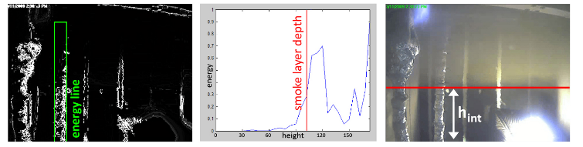
Video-based smoke height estimation
gradient analysis
DWT-based energy line(s) Energy profile Detected smoke layer height
S. Verstockt – RABOT2012 multi-view video dataset

Slide 17
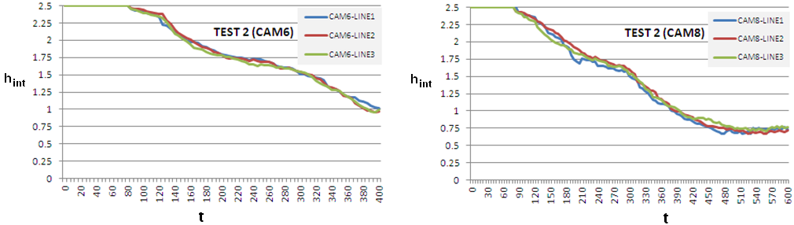
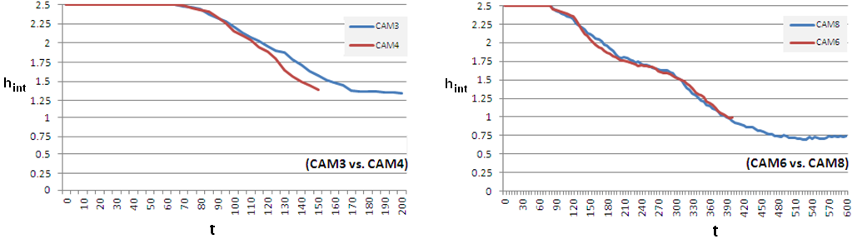
Video-based smoke height estimation: results
TEST 2
TEST 2
Multi-view extension
of single-view algorithms
TEST 1
TEST 2
S. Verstockt – RABOT2012 multi-view video dataset

Slide 18

  Multi-view extension of single-view algorithms
# cameras monitoring the scene from different viewpoints
→ problems that arise in one camera can (most probably)
be compensated by the others
We propose to analyze the within- and between-variance
of multi-view h_{int} estimations
within-variance: indication on the accuracy of a camera’s measurements
between-variance: indication regarding the certainty of the overall measurements
S. Verstockt – RABOT2012 multi-view video dataset

Slide 19
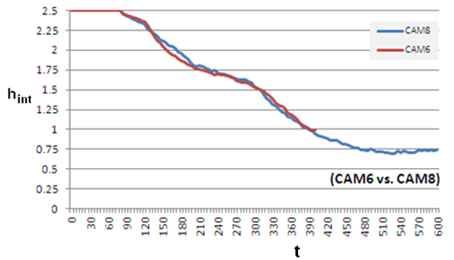
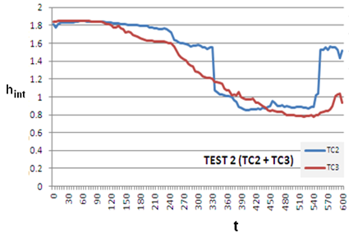
  Video vs. thermocouple based estimations
“Video observations are better (?)” / “Bigger scattering with TC (?)”
A. Coppalle et al. - Flame spread measurements on mattresses (ISFEH 2013)
Video-based estimation(s) of h_{int} follow
the trends of the TC2 and TC3 h_{int} measurements.
S. Verstockt – RABOT2012 multi-view video dataset

Slide 20

Conclusions
1) A multi-view video dataset of the large-scale multi-compartment
RABOT2012 fire tests is presented (and available online).
2) To study and evaluate the flame spread, a video-based algorithm
for flame spread analysis is proposed.
3) A multi-view extension (based on within- and between-variance)
for the video-based estimation of the smoke layer height is introduced.
http://multimedialab.elis.ugent.be/rabot2012/
Rabot2012
  Questions?
S. Verstockt – RABOT2012 multi-view video dataset

Slide 21
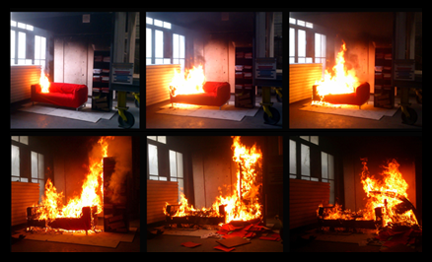
Questions?
S. Verstockt – RABOT2012 multi-view video dataset

